Slide 1
Introduction to Electric Circuits
Ctrl+Alt+Elite

Slide 2
Introduction
In order to understand basic circuits, it is imperative to have a good understanding of the atomic structure and how the electrons, protons and neutrons are layed out. An atom is the smallest possible piece of element. It consists of a nucleus; that contains protons and neutrons, and electrons; that orbit the nucleus.
Protons are positively charged particles.
Electrons are negatively charged particles.
Neutrons as the name indicate are neutral and have no charge.

Slide 3
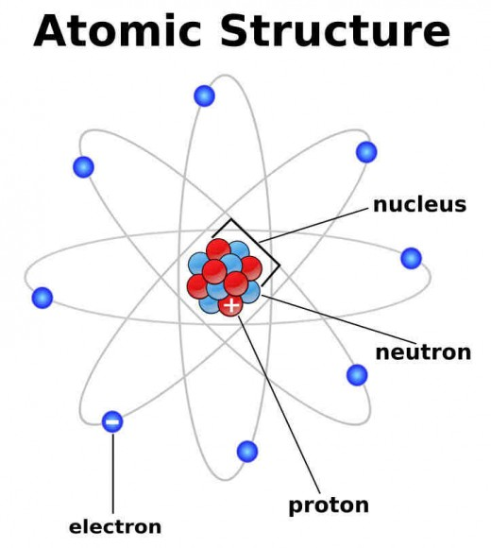
Introduction

Slide 4
What is Electricity?
Electricity is a form of Energy
Electricity is the flow of Electrons.
Electricity is usually generated by a device
Electric Generator ( convert mechanical energy to electrical energy)
Wind turbines (convert wind into electrical energy)
Notes:
An electric circuit is a path where current can flow from a higher voltage to a lower voltage. Electricity is a movement of electrons from high potential to low potential. In this regard, we can define an electric circuit as an interconnection of electrical elements. It can as simple as an connection of a LED lamp and a power source to a more complex connection with many more components such resistor, diodes, capacitors etc. Most of the components will be define in this unit.

Slide 5
What is Current?
Current is the movement of Electron from high potential to low potential.
In our case, we define an electric charge as an electron
Current is the rate at which electrical charges pass through a wire
Notes:
An electric circuit is a path where current can flow from a higher voltage to a lower voltage. Electricity is a movement of electrons from high potential to low potential. In this regard, we can define an electric circuit as an interconnection of electrical elements. It can as simple as an connection of a LED lamp and a power source to a more complex connection with many more components such resistor, diodes, capacitors etc. Most of the components will be define in this unit.

Slide 6
What is current?
Let’s examine the water flow below

Slide 7

Water Flow
Let’s observe and discuss water flow from a tank
Notes:
Thanks to Dr. Visvakumar Aravinthan(Dr. Ara) Professor and advisor at EECS department at Wichita State University for the great notes.

Slide 8
Water Flow
Lets observe and discuss water flow from a tank
Potential
(Water)
Path
Notes:
Thanks to Dr. Visvakumar Aravinthan(Dr. Ara) Professor and advisor at EECS department at Wichita State University for the great notes.

Slide 9
Water Flow
Let’s observe and discuss water flow from a tank
Notes:
Thanks to Dr. Visvakumar Aravinthan(Dr. Ara) Professor and advisor at EECS department at Wichita State University for the great notes.

Slide 10
Water Flow
Let’s observe and discuss water flow from a tank
Notes:
Thanks to Dr. Visvakumar Aravinthan(Dr. Ara) Professor and advisor at EECS department at Wichita State University for the great notes.

Slide 11
Water Flow
Let’s observe and discuss water flow from a tank
Notes:
Thanks to Dr. Visvakumar Aravinthan(Dr. Ara) Professor and advisor at EECS department at Wichita State University for the great notes.

Slide 12
Water Flow
Let’s observe and discuss water flow from a tank
Notes:
Thanks to Dr. Visvakumar Aravinthan(Dr. Ara) Professor and advisor at EECS department at Wichita State University for the great notes.

Slide 13
Water Flow
Some of my observations
There needs to be a physical path for water to flow
Water will flow from the high potential end to the low potential end
Water flow depends on the size of the path
Any block would reduce the flow of water
Notes:
Thanks to Dr. Visvakumar Aravinthan(Dr. Ara) Professor and advisor at EECS department at Wichita State University for the great notes.

Slide 14
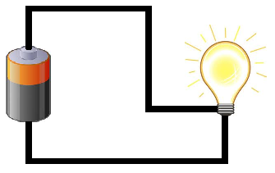
Electric Circuits
Example
Notes:
Thanks to Dr. Visvakumar Aravinthan(Dr. Ara) Professor and advisor at EECS department at Wichita State University for the great notes.

Slide 15
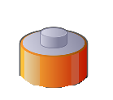
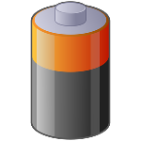

Compare with Water Flow
Electric Circuit
Water Flow
Notes:
Thanks to Dr. Visvakumar Aravinthan(Dr. Ara) Professor and advisor at EECS department at Wichita State University for the great notes.

Slide 16
Electric Circuits
Example
Path
Potential Difference
What flows instead of WATER
Notes:
Thanks to Dr. Visvakumar Aravinthan(Dr. Ara) Professor and advisor at EECS department at Wichita State University for the great notes.

Slide 17
Breadboard Introduction
A Breadboard is a matrix board pin connection used to connect electric circuits.
On each side of the board, there are two parallel lines:
one red line with a positive (+) sign of top
one blue line with a negative (-) sign.
Pin connection is along the column.
The rest of the matrix in the middle is connected along the row with a divide in the middle.

Slide 18
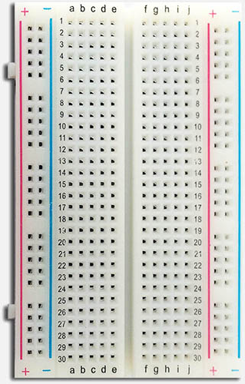
Breadboard
Breadboard
+ and – on each side
These columns are all connected
Prototyping area is the rows 1-30
Rows are connected
But not across the middle

Slide 19
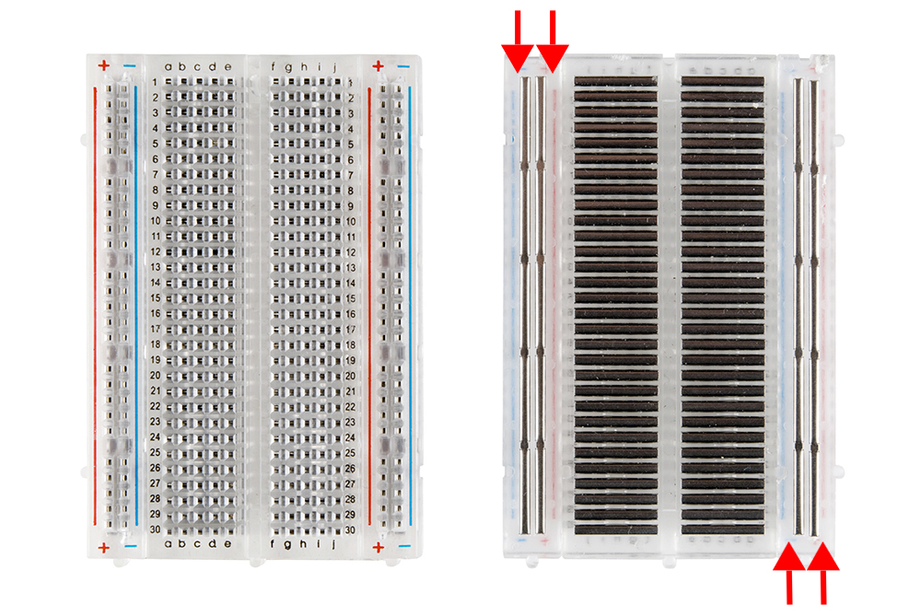
Breadboard
Breadboard pin connection
Row connection
Power connection

Slide 20
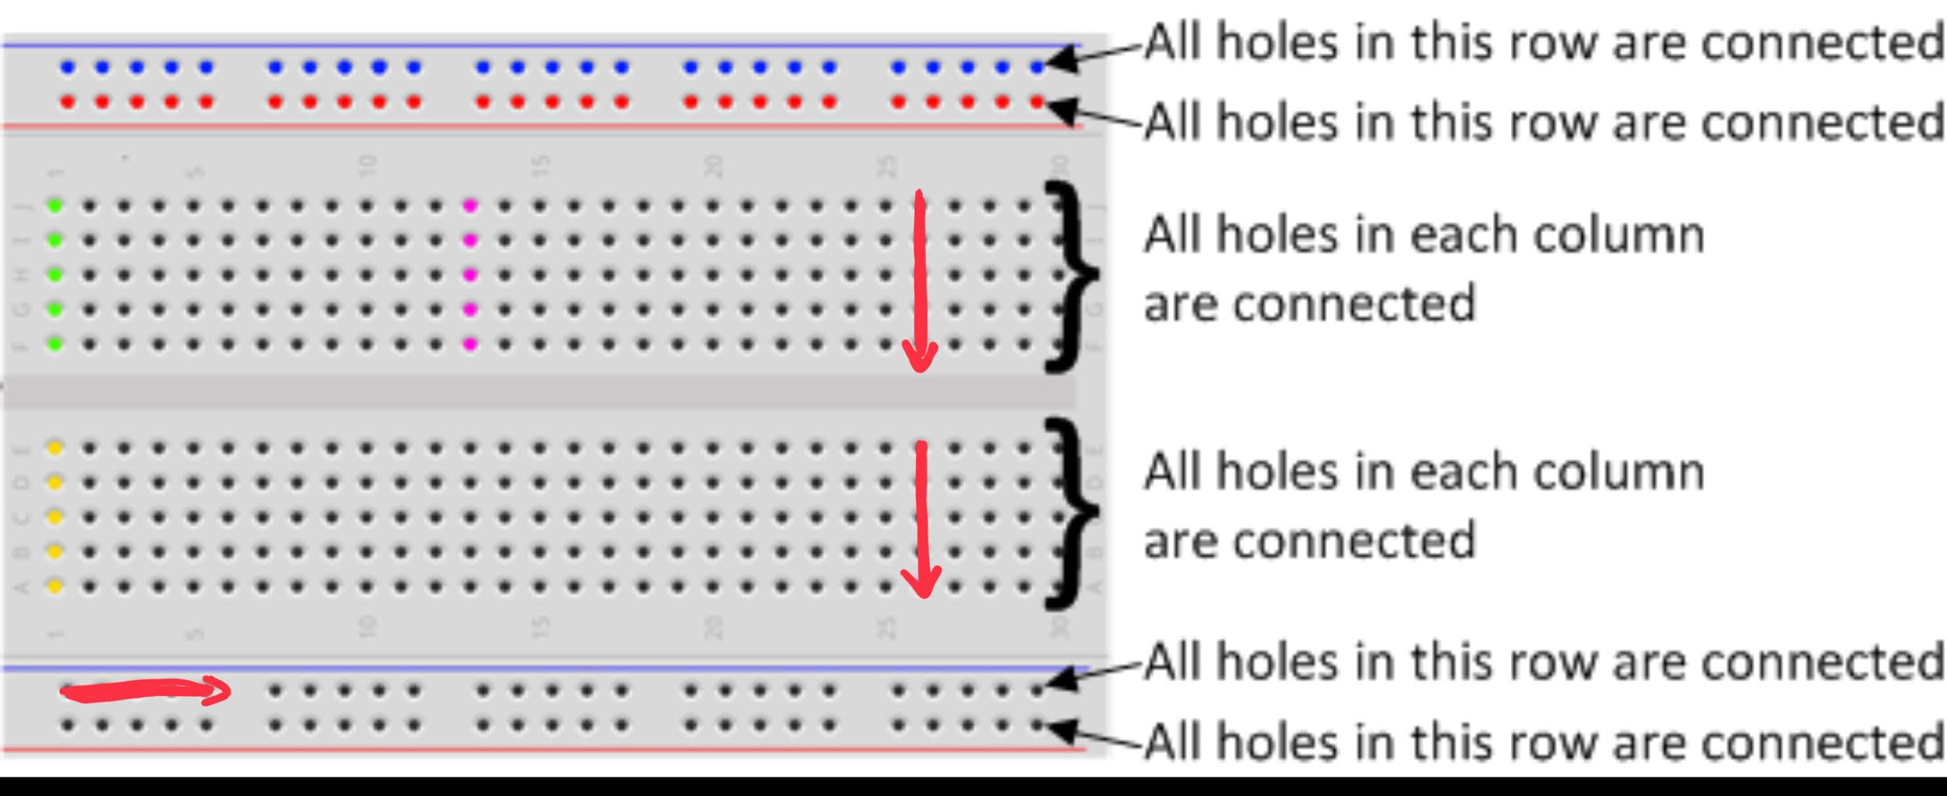
Breadboard
IMPORTANT!
It is imperative to understand the how the pins are connected on the breadboard.
This picture illustrates how the pins are connected.

Slide 21
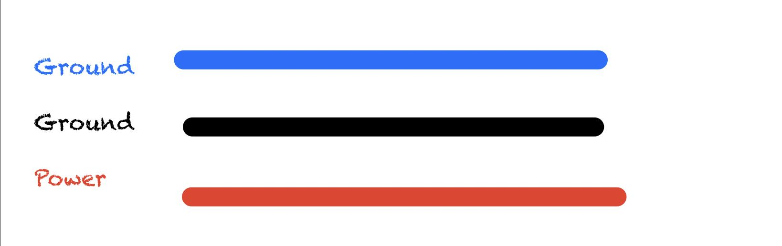
Color Convention
In this course we will always use:
Black or blue wire to connect to the Ground of the Breadboard
Red wire to connect to Power of the Breadboard.
Notes:
When building circuits on the Breadboard,Students can blue wire to connect to ground. However, later on, we will be using black wire as ground.

Slide 22
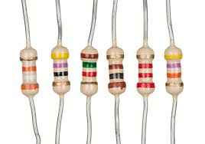
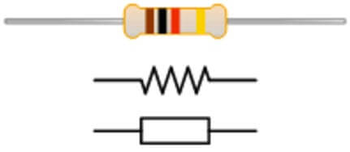
Electric Components
Resistors
A device with a specific resistance to the passage of electric current. It is used in circuit to control the flow of current and voltage drop. No polarity, It does not matter how you connect the resistor in your circuit.

Slide 23
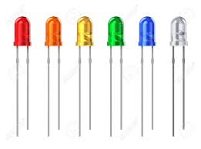
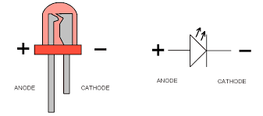
Electric Components
L.E.D
LED is a Light Emitting Diode. It works like a light bulb in the context we are using for this course.
Long leg is Positive
Short leg is Negative

Slide 24
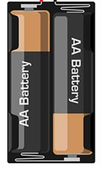
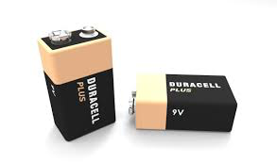
Electric Components
Battery or Power Source
A device consisting of two terminal and supply electric power to other electrical components.

Slide 25
Electric Components
Potentiometer
A potentiometer is a resistor with three terminal and a knob to adjust the resistance value.It can be used in different manner. However, in this unit we will be only as variable resistor.
Notes:
A variable is a resistor where we can control the resistance with usually a knob. Resistivity change according to the set value.

Slide 26
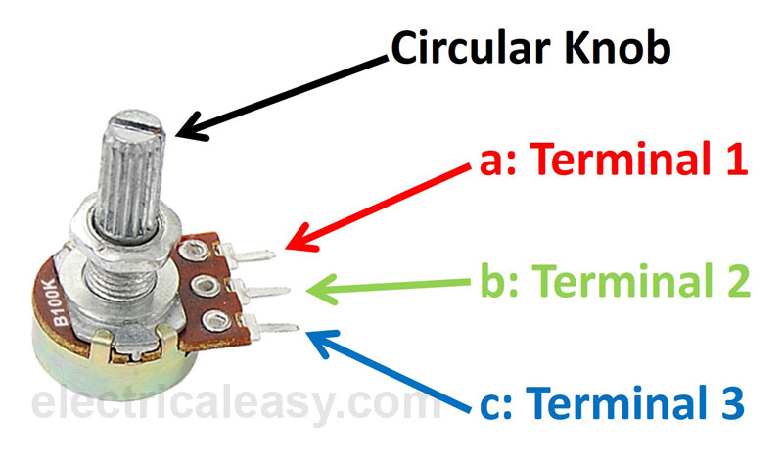
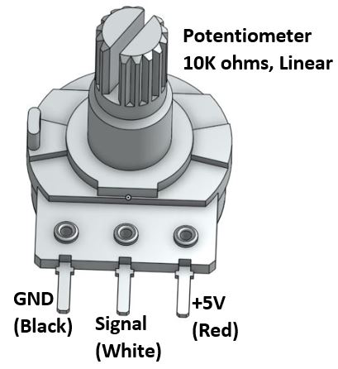
Electric Components
Here are the terminal connection of the potentiometer

Slide 27
Activity #1
In this Activity You are going to build your first electric circuit.
You will need the following items:
A battery
A resistor
An LED
A Breadboard
A few sets of wires (As needed)

Slide 28
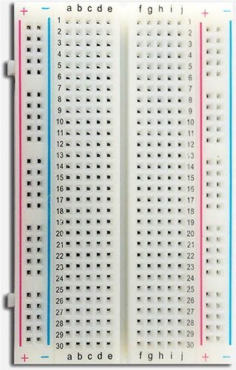
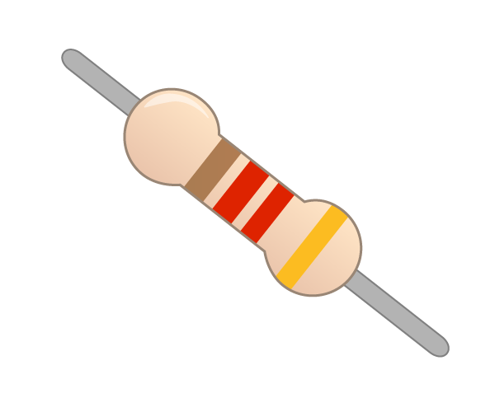
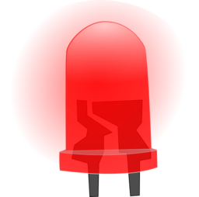
Activity #1 (Suite)
First Circuit

Slide 29
Types of Circuit
We connected a circuit in three different manners. We connect each components in parallel, we can connect them in series and/or a combination of both.
Parallel Circuit
A circuit where everything is connected in parallel
Voltage is the same across each components
The total current in the circuit is the sum of all the other current.
Series Circuit
The same current goes through each component
The voltage across each component is different

Slide 30
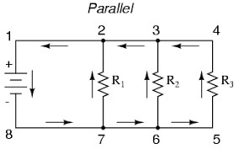
Parallel Resistors
Parallel Resistors
A parallel circuit has two or more paths for current to flow through.
Voltage is the same across each component of the parallel circuit.
The sum of the currents entering each point (node) is equal to the sum of currents exiting the point (node).
In this circuit below the points (nodes) are 2, 3, 6 & 7.

Slide 31
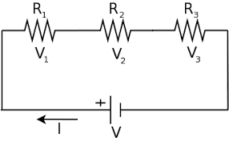
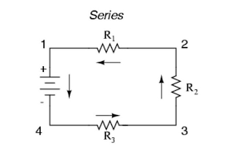
Series Resistors
Here we have 3 different resistors connected side by side.
Current only have one path.
Each resistor drops the voltage.
The voltages V1, V2, and V3 are different in values.

Slide 32
Differences
Difference between parallel and series
series circuit:
if a component is disconnected, the circuit is broken and nothing will work.
Good way to check if all components are working in your circuit.
Only one current goes through the circuit.

Slide 33
Differences
Difference between parallel and series
Parallel Circuit:
Multiple current
If a component is disconnected the circuit may still work.
Components can enjoy the full voltage discharge by the battery.

Slide 34
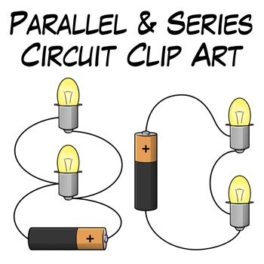
Which one is series connected?
Left or Right circuit?
Notes:
The one on the right is series connected. The one on the left is a parallel circuit.

Slide 35
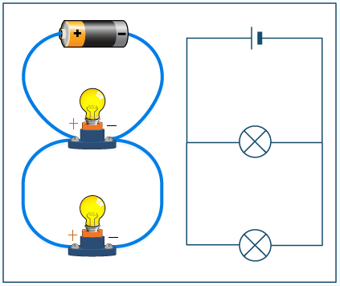
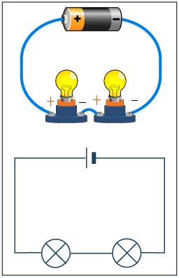
Wrap-up
PARALLEL vs SERIES

Slide 36
Activity #2
In this activity we will connect both parallel and series connected circuit.
We will use a resistor to control how much voltage goes into the LEDs.
Notes:
Give them all the components they need except the battery and see if they can build these circuit by themselves.

Slide 37
Activity #2 (suite)
In this Activity You are going to build your first electric circuit. You will need the following items:
A battery
A resistor (selected by instructor)
Two LEDs
A Breadboard
A few sets of wires (As needed)
Notes:
Let the students try with help from the instructors before displaying the solution.

Slide 38
Activity #2 (suite)
First connect the LEDs in series. Try building this circuit below using the components provided.
Place a resistor between the battery and the LEDs.

Slide 39
Solution for Activity #2
Second Circuit:
Notes:
Battery is connected to Red to red and Black to blue
Resistor is directly connected to the Power (red +) from the breadboard to Pin 19
Long leg of the first LED is also connected to pin 19
Short leg of the firs LED is connected to pin 18
Long leg of second LED is connected to pin as well
Short leg of the second LED is connected to pin 17
Note: short leg of second LED can be directly connected to the ground
Yellow wire goes from Blue (ground) to pin 17
Ask them to remove one buld and see if the circuit still works.
Once everyone is done dismantle everything and let them try do it in parallel.

Slide 40
Activity #2 (suite)
Parallel Circuit.
As you can see below now the LED share the same pinson both sides.

Slide 41
Solution for Activity #2
Third Circuit.
Notes:
Power is connected red to red black to blue
Resistor is directly connected to power and pin 21
Both LEDs are connected to pin 21 for long legs and pin 19 for short leg
Yellow wire goes from pin 19 to ground of the breadboard.
Once they get their circuit running ask them to remove one LED and see if the other one is still on or not.
Draw conclusion on the difference between series and parallel
Use the house as an example of parallel connected circuit and why its better than series.

Slide 42
Activity #3
Controlling the brightness of an LED
In this activity you will build a circuit using the following components in order to control the brightness of an LED by deciding how much resistance goes through the circuit.
Power Source (Battery)
LED
Potentiometer
Wires
Breadboard
Notes:
Show them how to connect the potentiometer and see if they can build this circuit by themselves

Slide 43
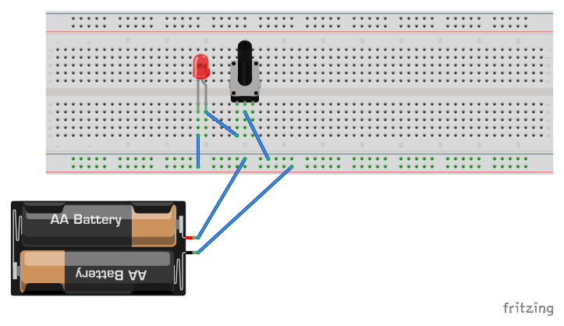
Solution for Activity #3
Solution
Notes:
DO NOT SOLDER THE WIRE TO THE POTENTIOMETER
USE THE BREADBOARD PIN TO CONNECT THEM
Circuit was built using Fritzing
So
http://fritzing.org/home/

Slide 44
Soldering
Learning Objectives
To understand the basics of soldering.
To know how to effectively use a soldering iron.
To achieve solid soldered joints.
To understand all the safety features and other rules involved when using a soldering iron.
Notes:
On this day the following should covered:
The safety involved when soldering a dn handling the soldering iron
DO NOT let them handle the soldering Iron without supervision.
Have them solder the components for the hot wire.

Slide 45
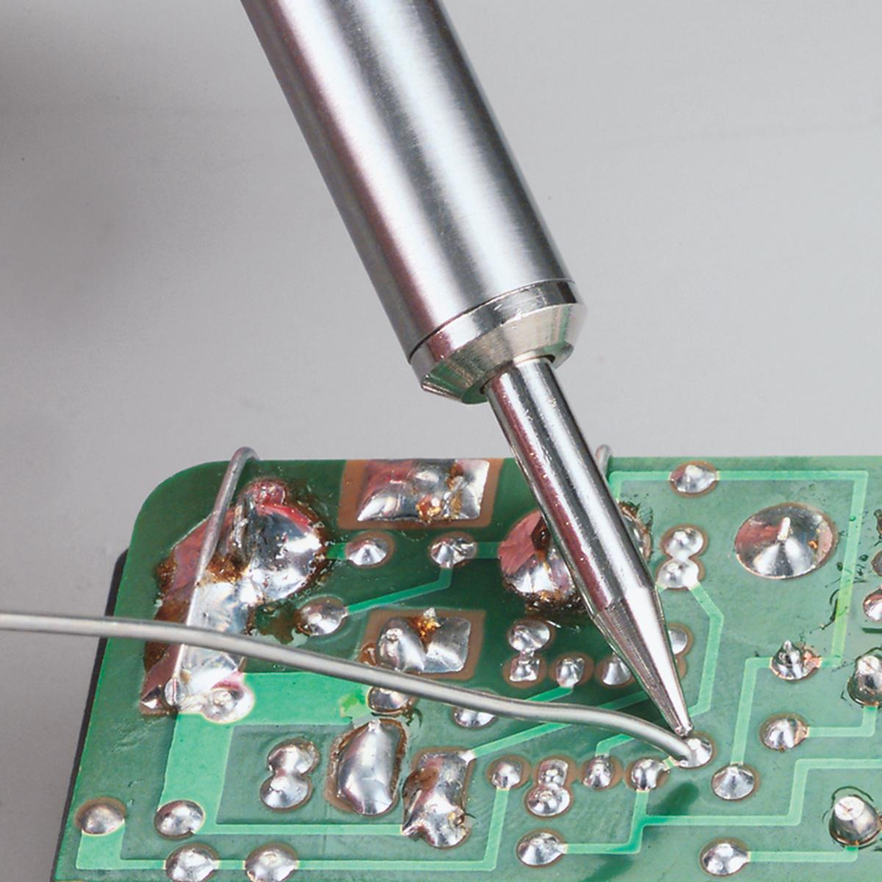
What is soldering?
Soldering is a method of joining metals.
Using heat to melt a filler.
Join two electrical components

Slide 46
Tools needed
Safety Glasses
Soldering Station Including:
Solder stand
Solder Iron
Solder
Solder wick
Wire cutter.
Wire stripper
Wet sponge

Slide 47
What is solder?
Solder is a metal alloy.
It is tin and copper.
Lead free solder.
Solder melts between 210- 230ºC.

Slide 48

Safety First!
What would happen if I put my hand in boiling water?
Water boils at 100º C.

Slide 49
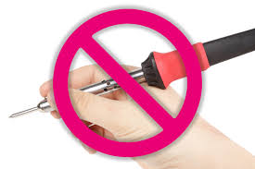
Stop!
The Soldering Iron is heated to 350ºC
DO NOT TOUCH IT WITHOUT APPROVAL!!
Never, under any circumstances, should you touch the metal part of the soldering iron.

Slide 50

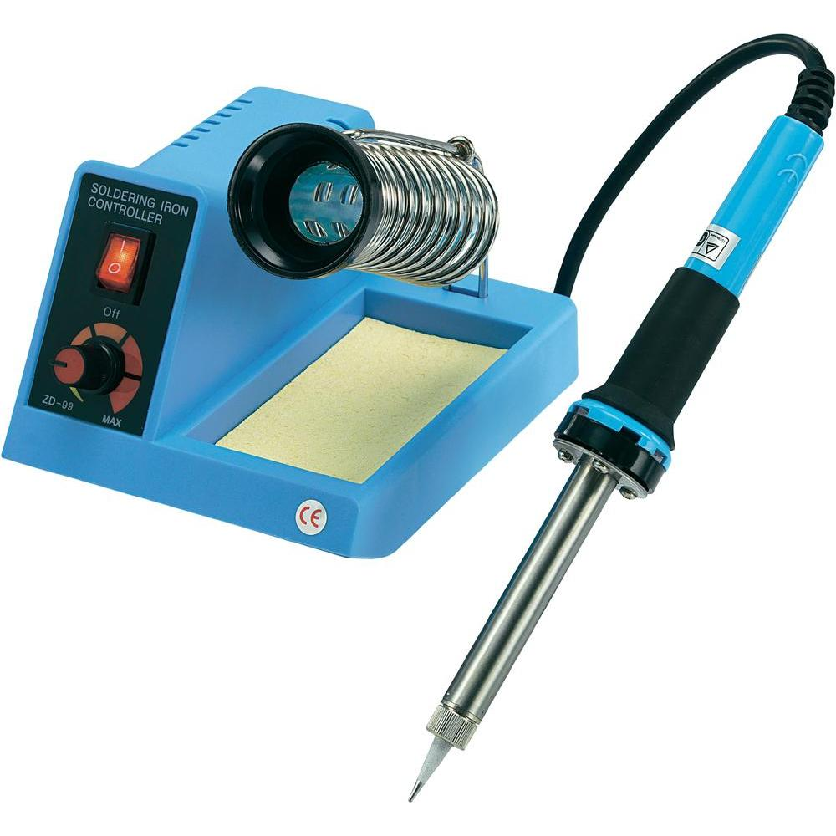
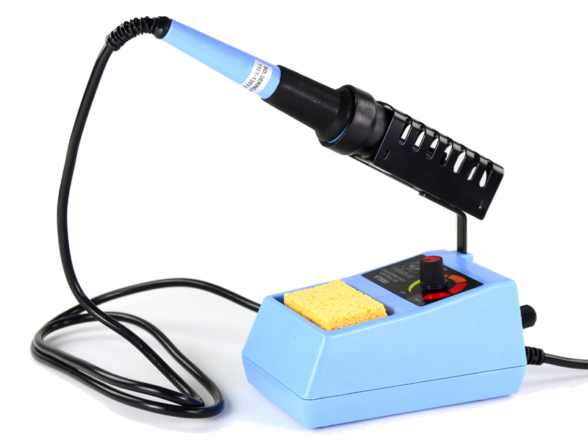
Safety First!
Always keep the pencil tip in stand. Never put on the table.

Slide 51
Hot Wire Game
Also known as Wire Loop Game
is a game that involves guiding a wire through a metal loop without touch it.
To be successful with the game you have move along the length of the wire without any contact.
If you touch the metal wire the buzzer will go off

Slide 52
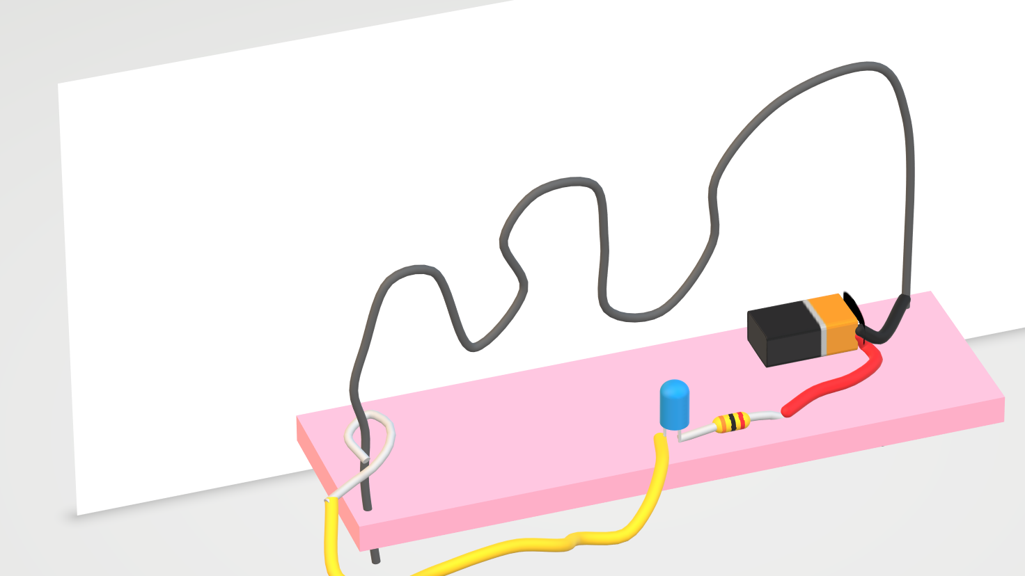
Hot Wire Game

Slide 53
Hot Wire Game
Components needed:
Battery
LED or Buzzer
Resistor
Uninsulated wire
Insulated wires
Foam or wood
Notes:
Check the unit 1 guide for other details on the wires needed.

Slide 54
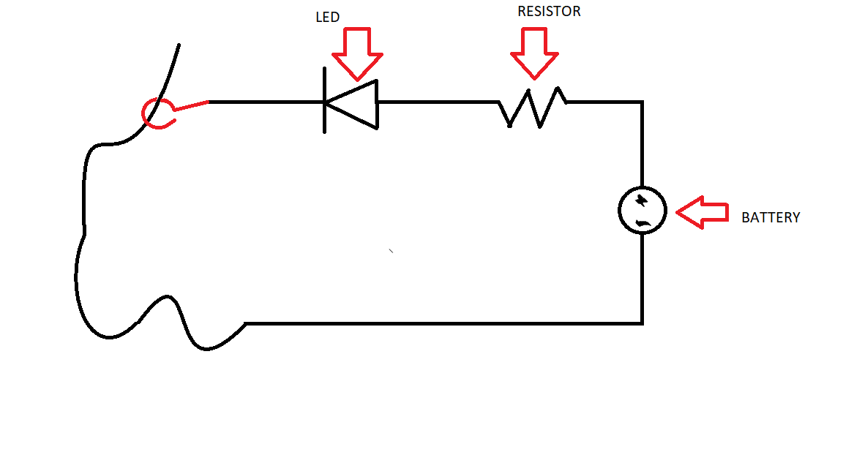
Hot Wire Game
Circuit diagram

Slide 55
Activity #4
Making Of The Hot Wire Game:
Twist the long uninsulated wire to make a path desired
Use a set of foam or wood to fixate the wire.
Solder the uninsulated Copper wire to the negative terminal of the Battery.
Solder the resistor to the positive terminal of the Battery
Solder the Long leg of the LED to the other side of the Resistor
Solder the hook handle to the negative terminal of the LED
Notes:
If you use a Buzzer instead of an LED make sure the positive terminal is connected properly or else the circuit might not as intended.

Slide 56
Solution for Activity #4
A Picture of the one we build.

